Slide 1
Baker City cycle classic
Traffic plan
Compiled by Niwa Flanagan
Flagmaster Racing for odot
Race date: June 26th-28th 2026 www.bakercitycyclingclassic.com

Slide 2
AGENDA
Stage 1
Stage 2
Stage 3

Slide 3
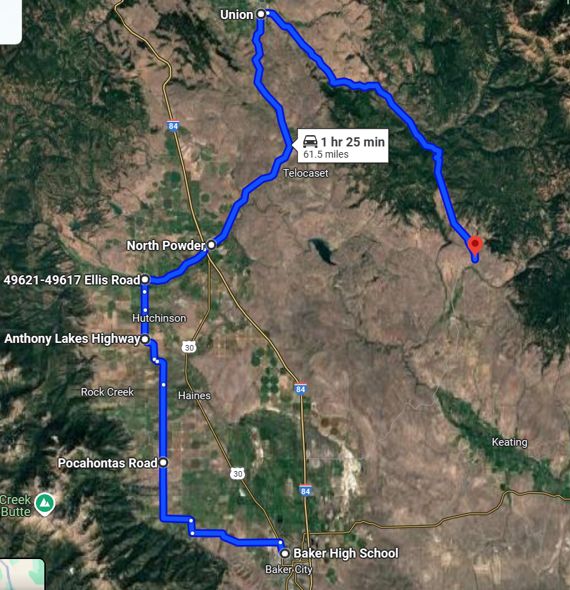
Stage 1
Notes:
The racers start off at the high school and follow a lead car and a tail. There will be a flagger at the beginning and then rotate to another position

Slide 4
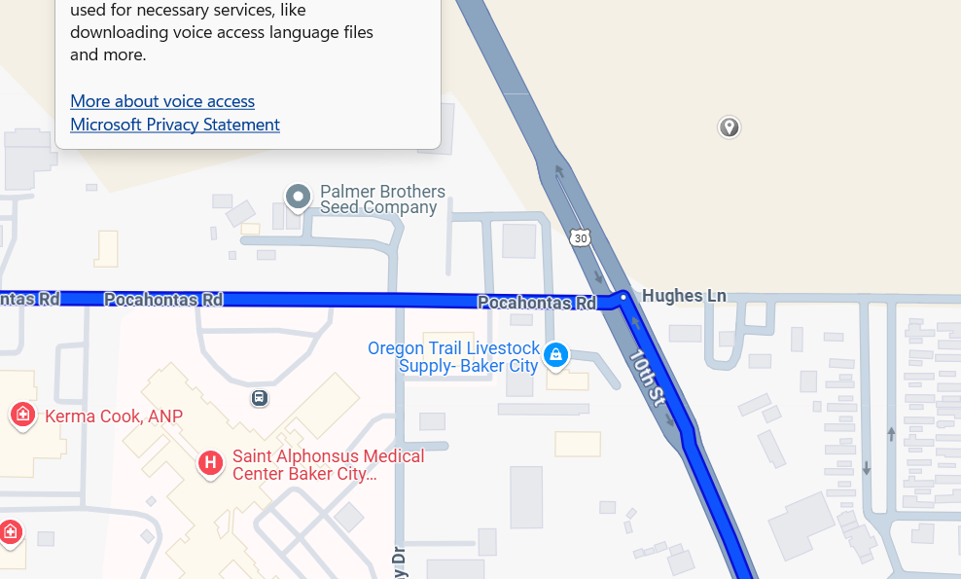




Notes:
Pocahontas and rock creek we have be prepared to stop road work ahead and flagger ahead @500 ft apart before coming onto flaggers posted at two locations.

Slide 5
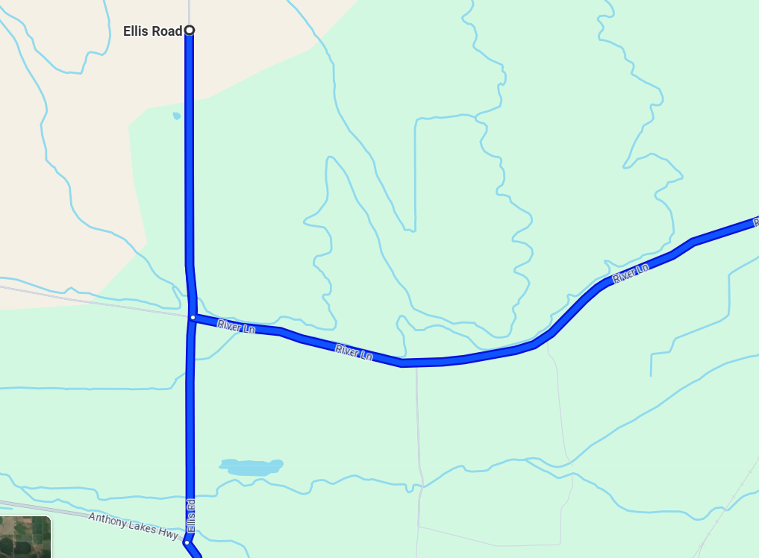



E
Notes:
Ellis road and North Powder road only requires two flagger with 3 caution flags 500 ft apart.

Slide 6
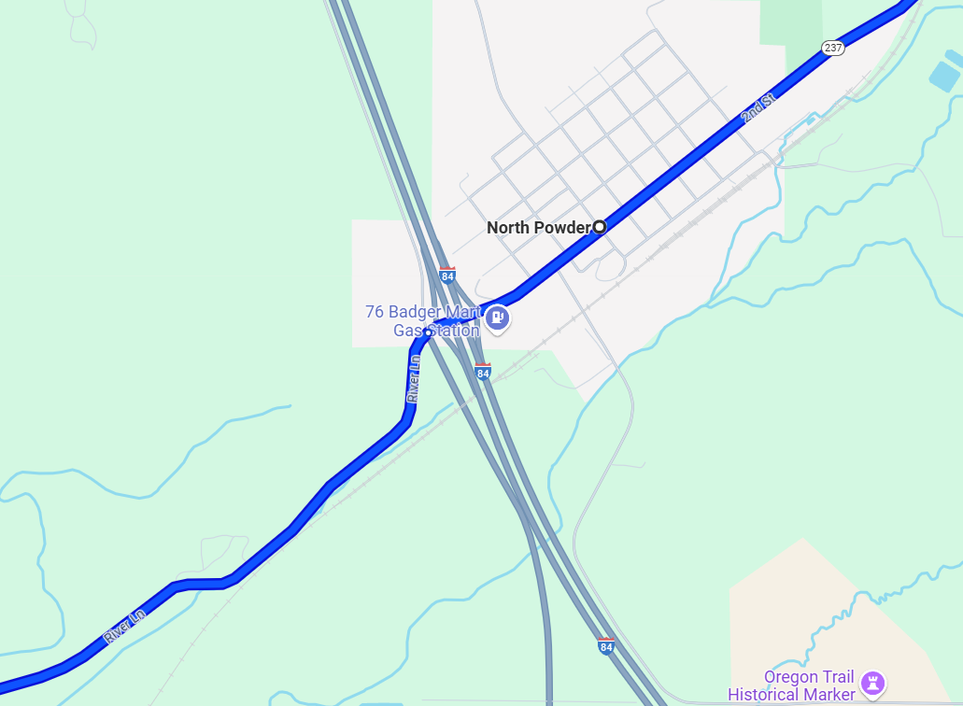
Notes:
North Powder requires 3 flaggers:
Protecting two off ramps coming off I84 onto North Powder with 3 flags @500 ft apart with a flagger on each ramp
Protecting frontage road and North powder with 3 flags @500 ft apart with 1 flagger protecting the traffic

Slide 7
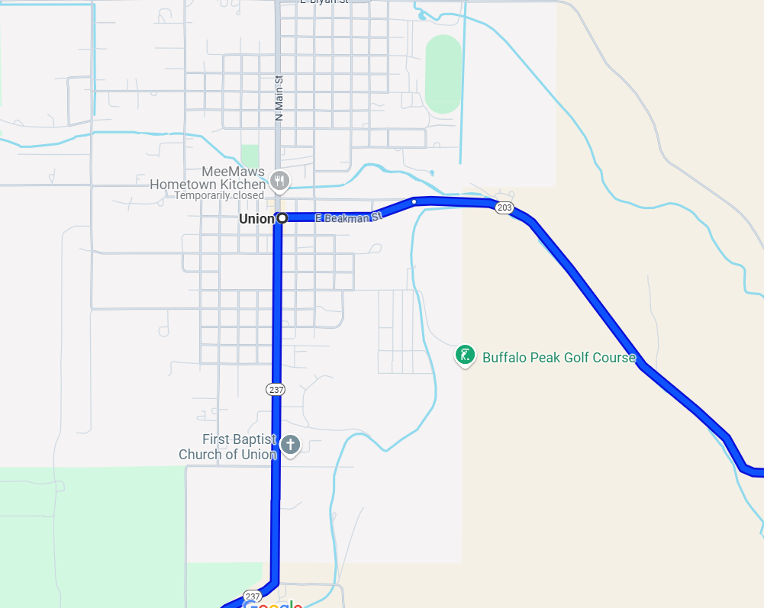
Notes:
Union needs two flaggers protecting the riders to make a right turn with two certified flaggers protecting the intersection with warning flags 100 ft apart with speed limit of 25mph

Slide 8
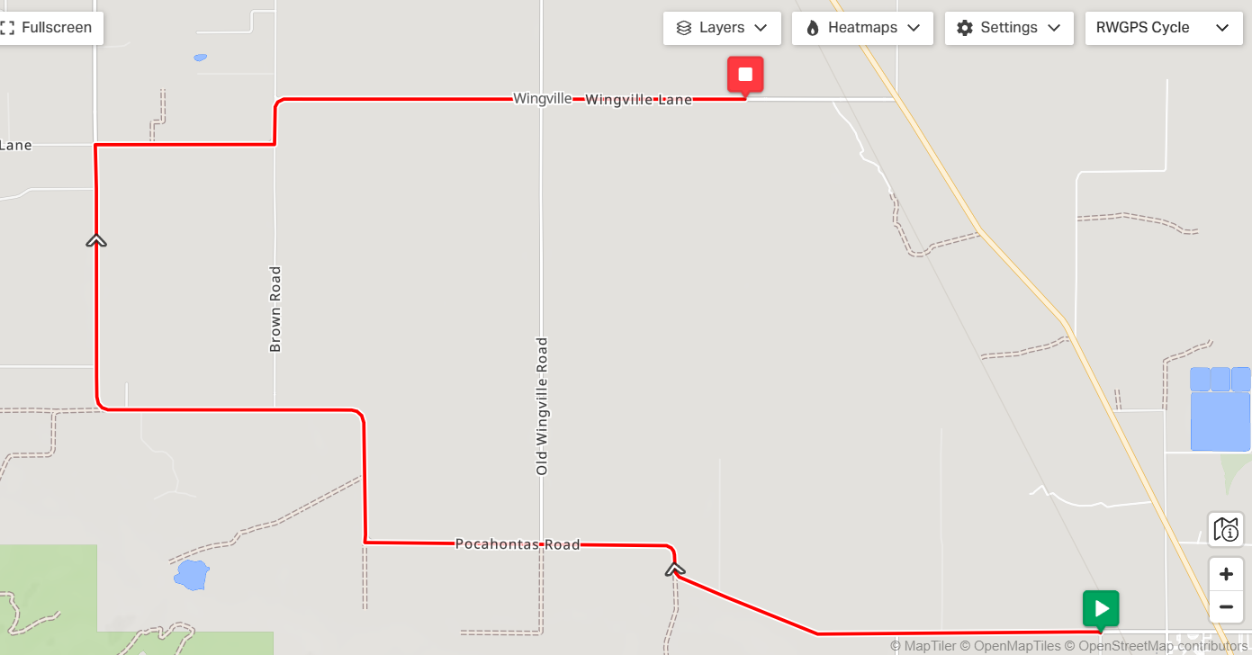
Stage 2
Notes:
Time Trials will not have a shuttle driver leading the way.

Slide 9
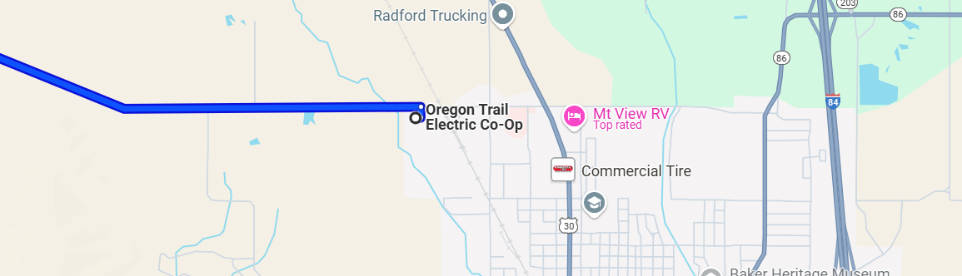
Notes:
One flagger is required at this location to stop traffic protecting cyclists with 3 signs 500 ft apart.

Slide 10
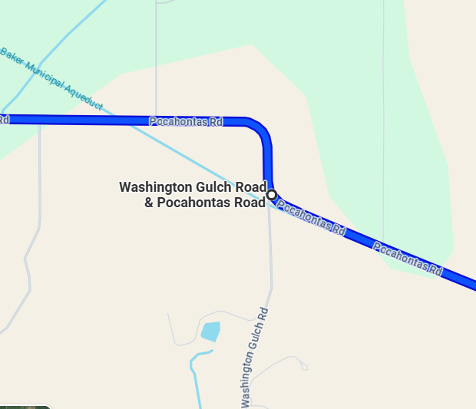

Notes:
Corner marshal is needed at this location to make sure cyclist are on the correct path

Slide 11
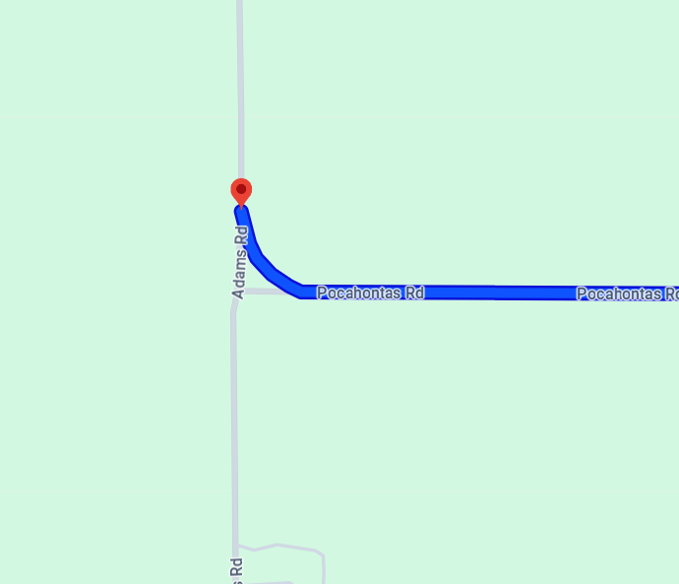
Notes:
Two corner Marshalls are needed at this location

Slide 12
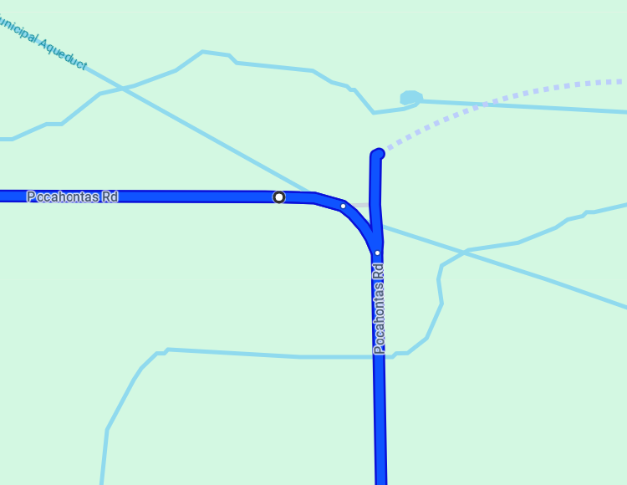
Notes:
One corner marshal is needed at this location allowing a smooth progression for individual cyclist

Slide 13
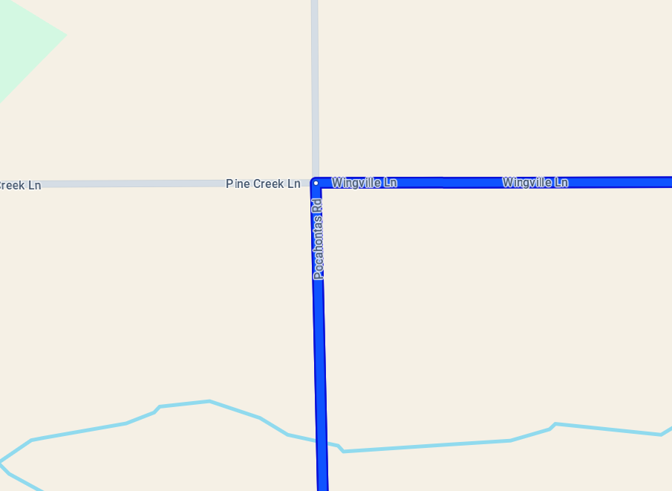
Notes:
Two flaggers are required at this location of Pocahontas and Wingville with signs @500 ft apart

Slide 14
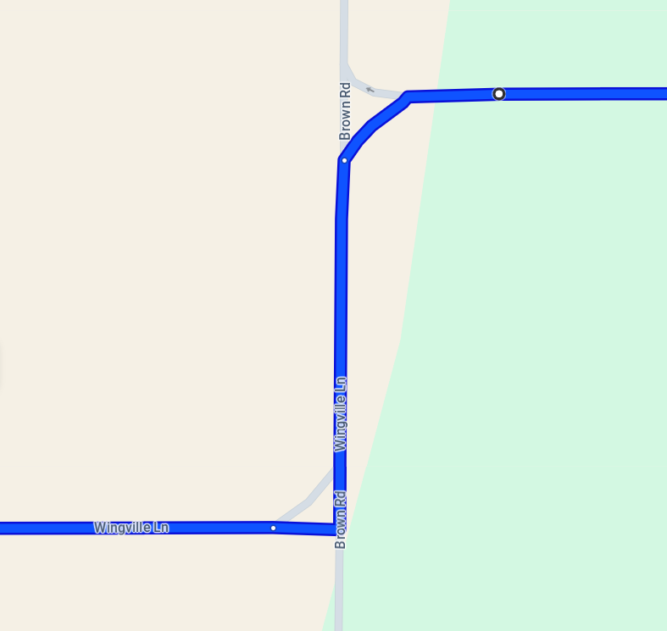
Notes:
Two corner marshals are required at this location

Slide 15
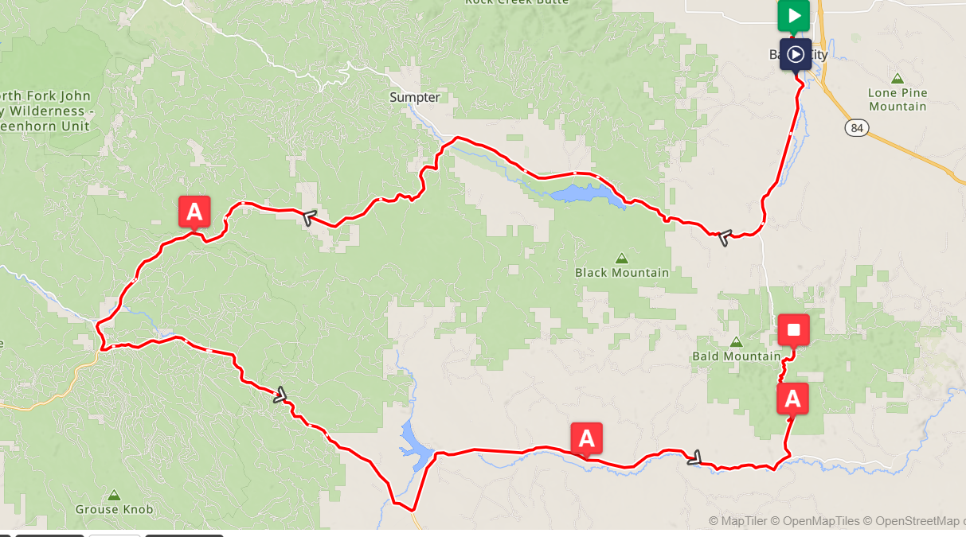
Stage 3
Notes:
Stage 3

Slide 16
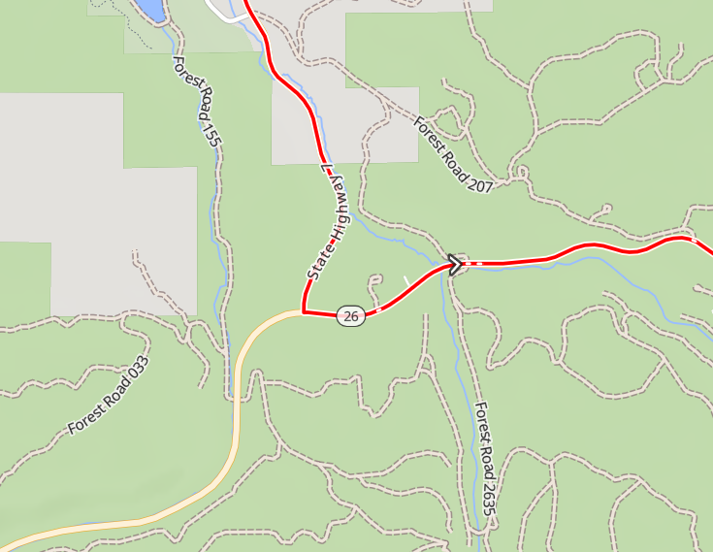
Notes:
Two Certified flaggers with 3 signs @500 ft apart-along with a spotter to help navigate the riders and traffic

Slide 17
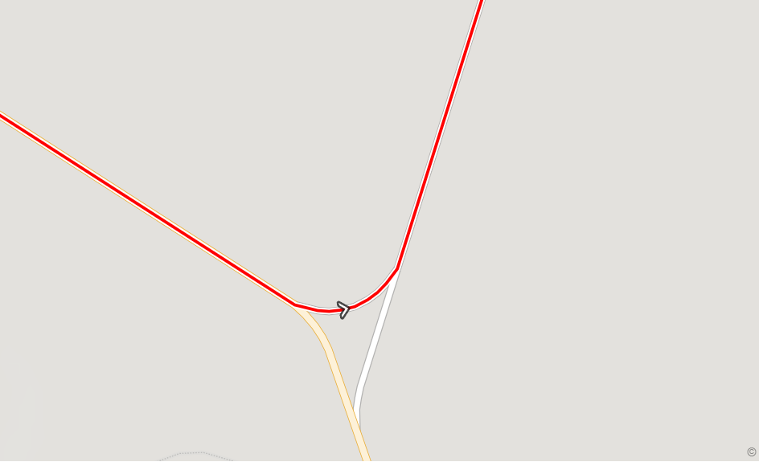
Notes:
Riders will follow the road while–two flaggers are needed to protect traffic from the wye-signs will be posted 500 ft apart

Slide 18
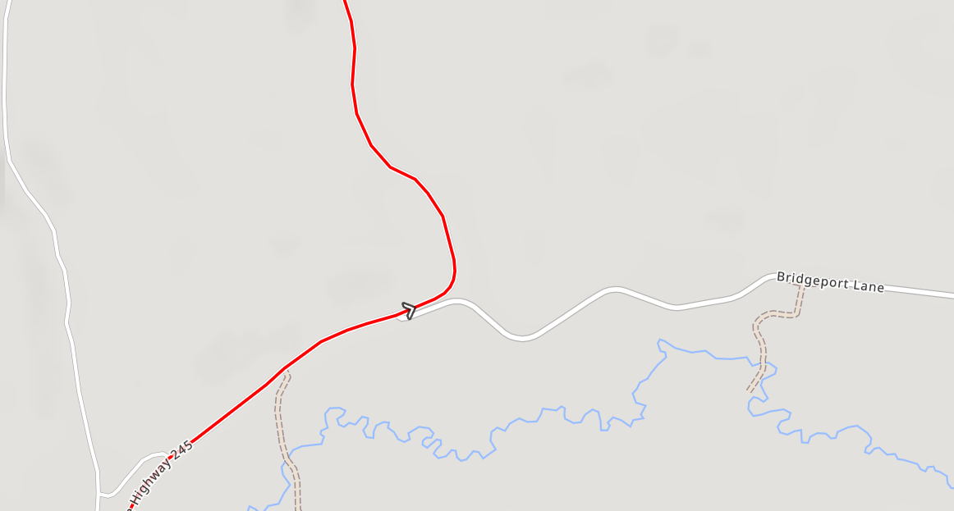
Notes:
One flagger needed to protect Bridgport Lane coming into hwy 245-1 flagger is needed with three signs at 500 ft apart

Slide 19
Key
Certified Flaggers
Corner Marshalls

