Slide 1
Baker City cycle classic Traffic plan Compiled by Niwa Flanagan Flagmaster Racing for odot Race date: June 20th-22nd 2025 https://maps.app.goo.gl/vsXWAZMvr5hZSp7o7

Slide 2
AGENDA
Stage 1
Stage 2
Stage 3

Slide 3
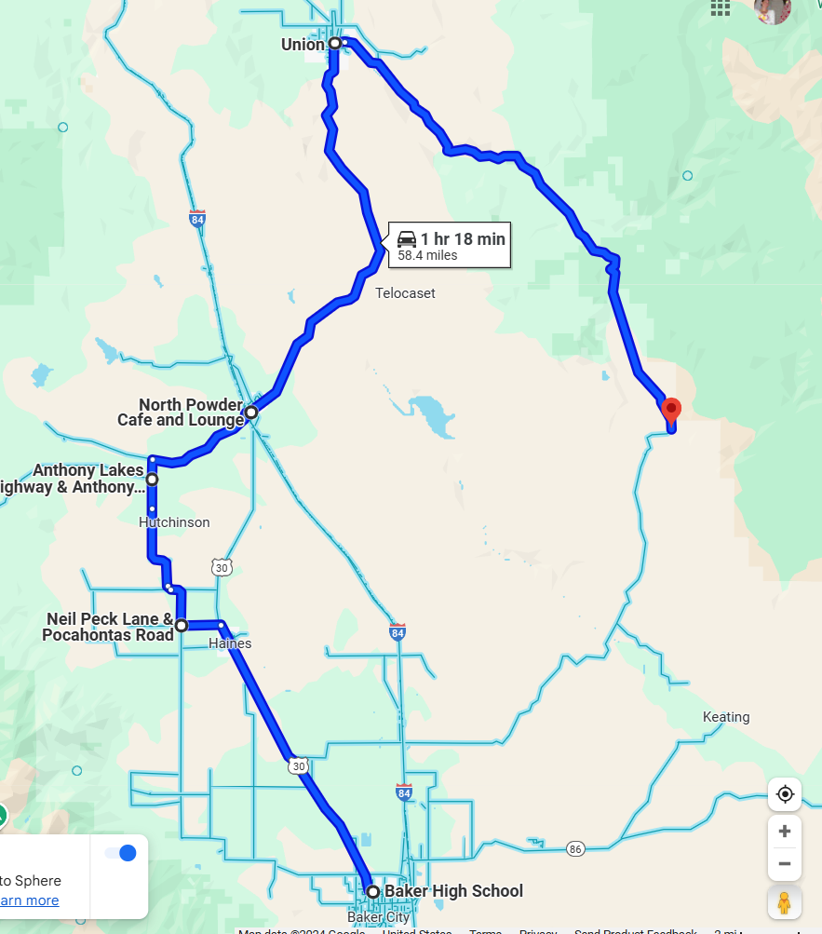
Stage 1
Notes:
The racers start off at the high school and follow a lead car and a tail.

Slide 4
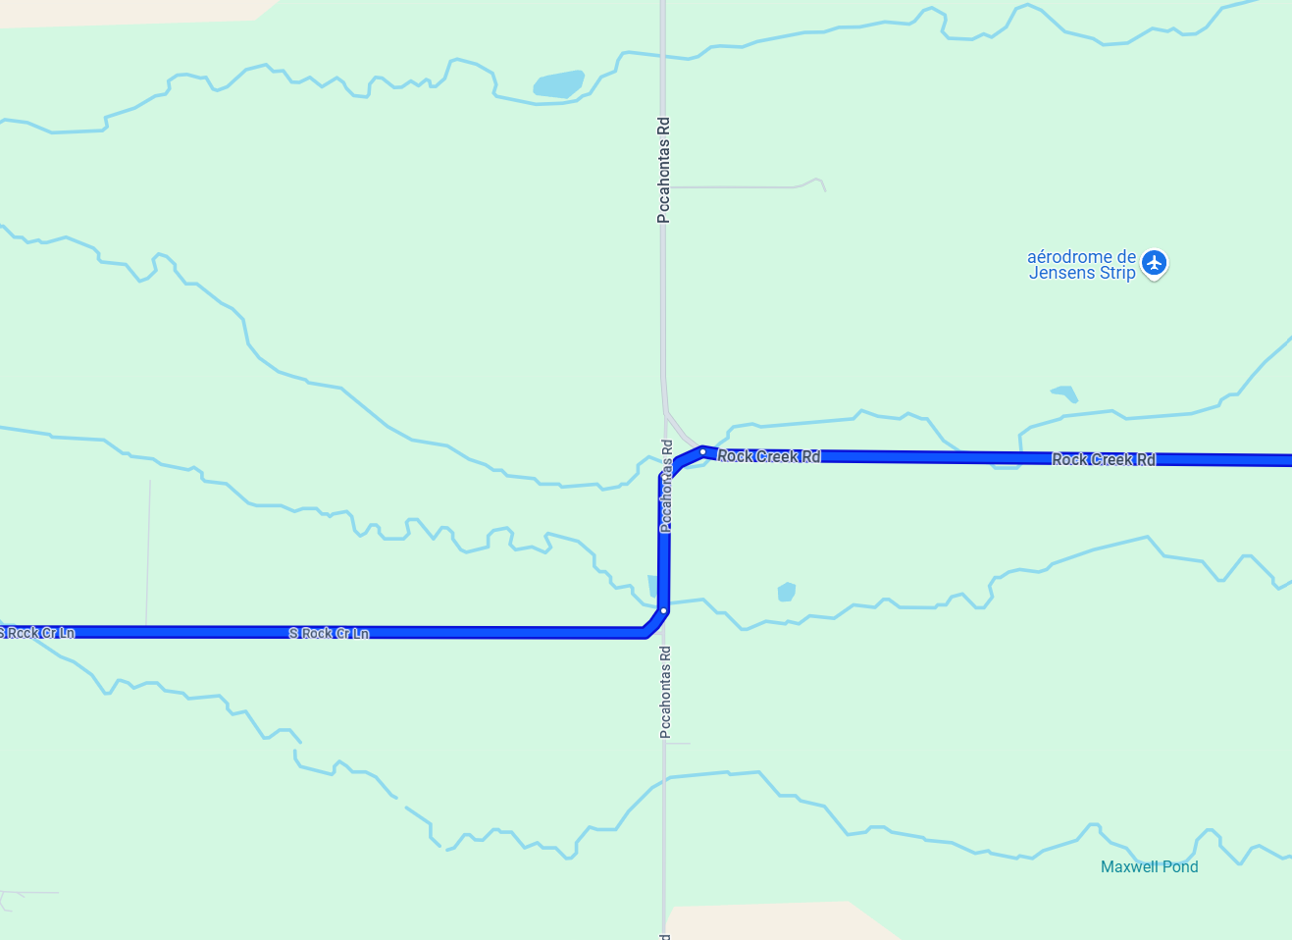
Notes:
Pocahontas and rock creek we have be prepared to stop road work ahead and flagger ahead @500 ft apart before coming onto flaggers posted at two locations.

Slide 5
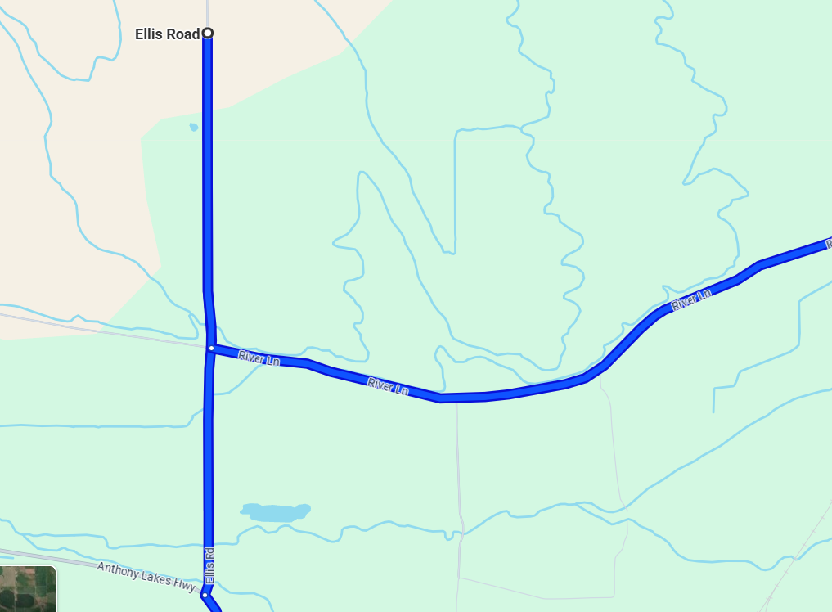
E
Notes:
Ellis road and North Powder road only requires two flagger with 3 caution flags 500 ft apart.

Slide 6
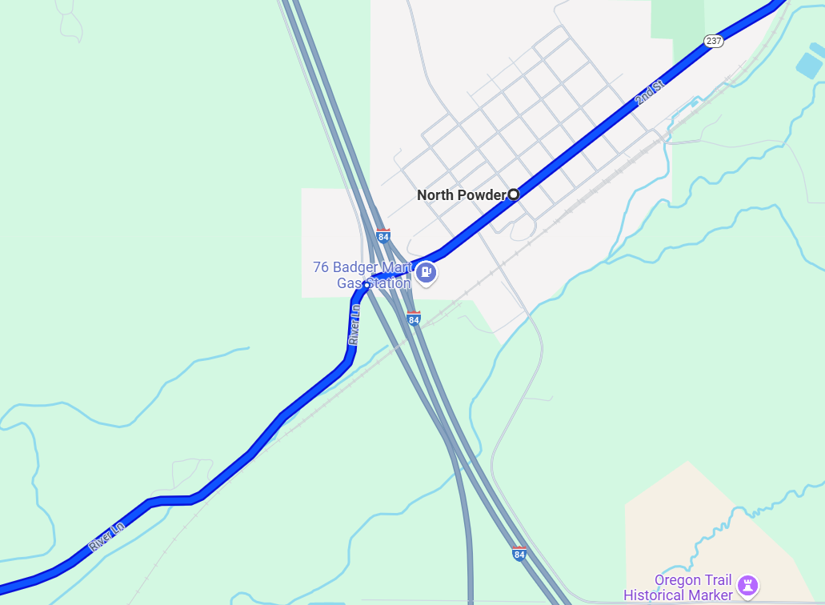
Notes:
North Powder requires 3 flaggers:
Protecting two off ramps coming off I84 onto North Powder with 3 flags @500 ft apart with a flagger on each ramp
Protecting frontage road and North powder with 3 flags @500 ft apart with 1 flagger protecting the traffic

Slide 7
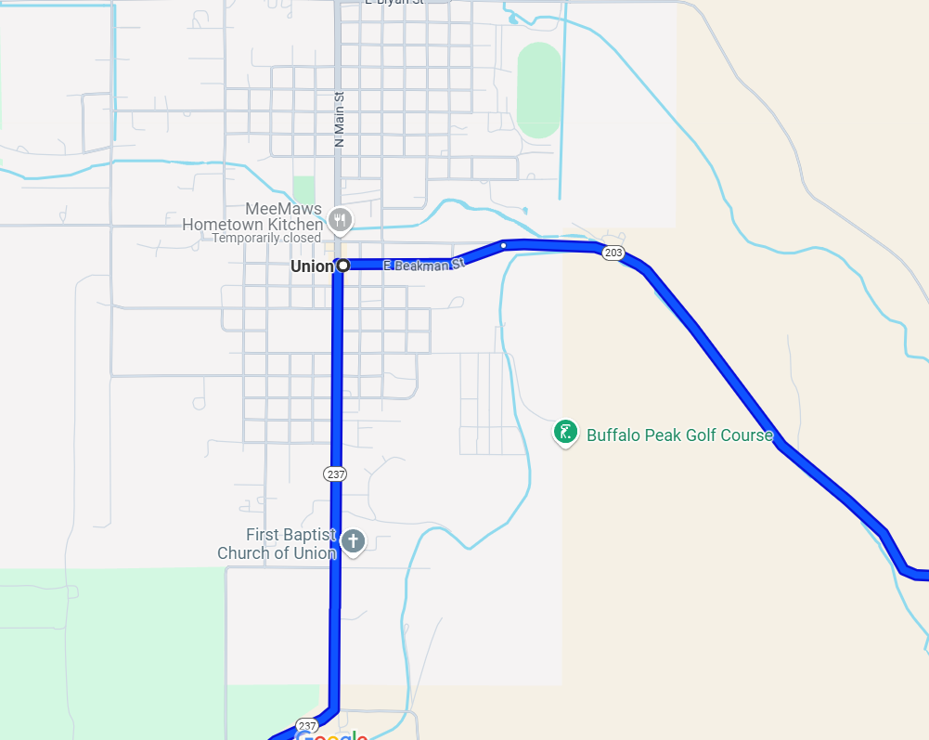
Notes:
Union needs two flaggers protecting the riders to make a right turn with two certified flaggers protecting the intersection with warning flags 100 ft apart with speed limit of 25mph

Slide 8
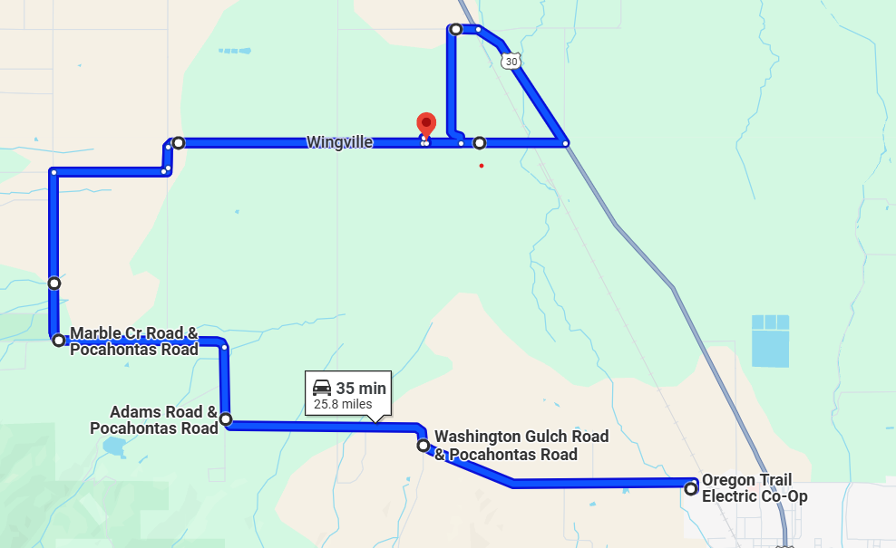
Stage 2
Notes:
Time Trials will not have a shuttle driver leading the way.

Slide 9
Notes:
One flagger is required at this location to stop traffic protecting cyclists with 3 signs 500 ft apart.

Slide 10
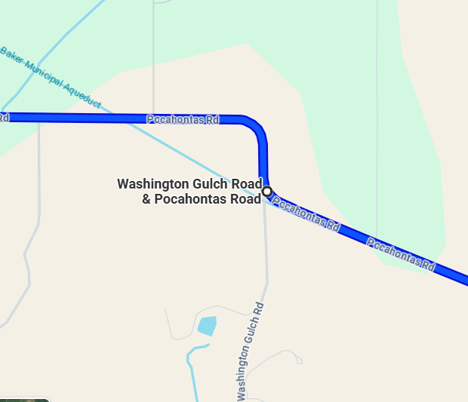
Notes:
Corner marshal is needed at this location to make sure cyclist are on the correct path

Slide 11
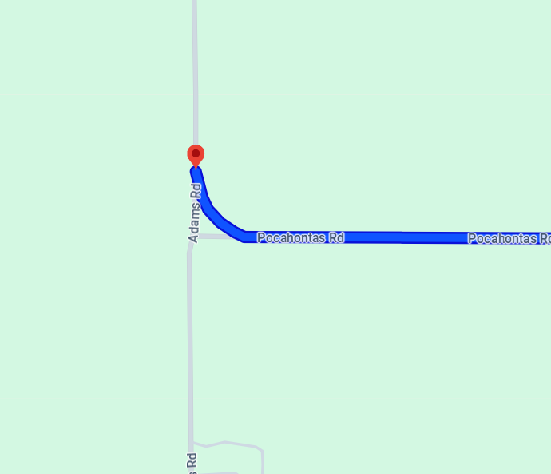
Notes:
Two corner Marshalls are needed at this location

Slide 12
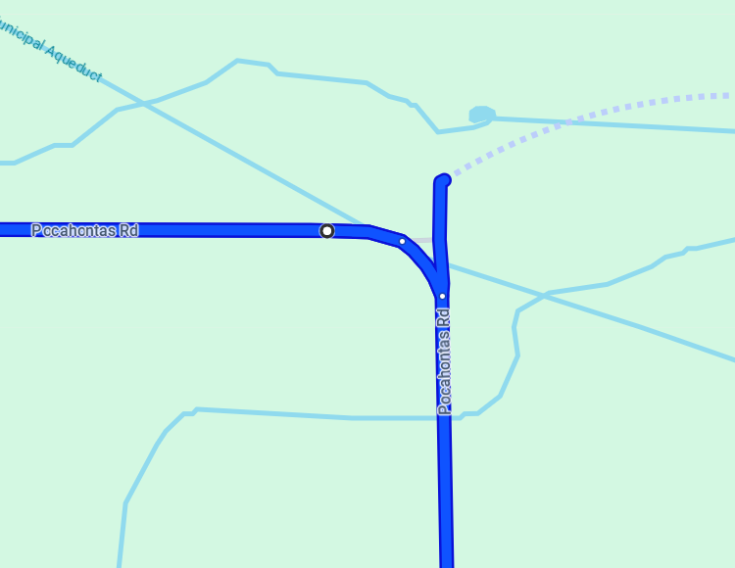
Notes:
One corner marshal is needed at this location allowing a smooth progression for individual cyclist

Slide 13
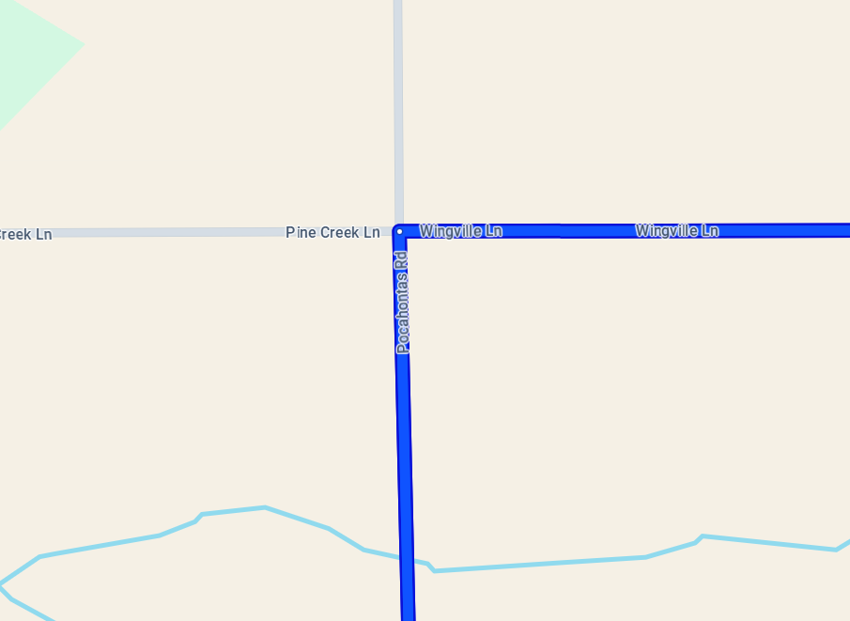
Notes:
Two flaggers are required at this location of Pocahontas and Wingville with signs @500 ft apart

Slide 14
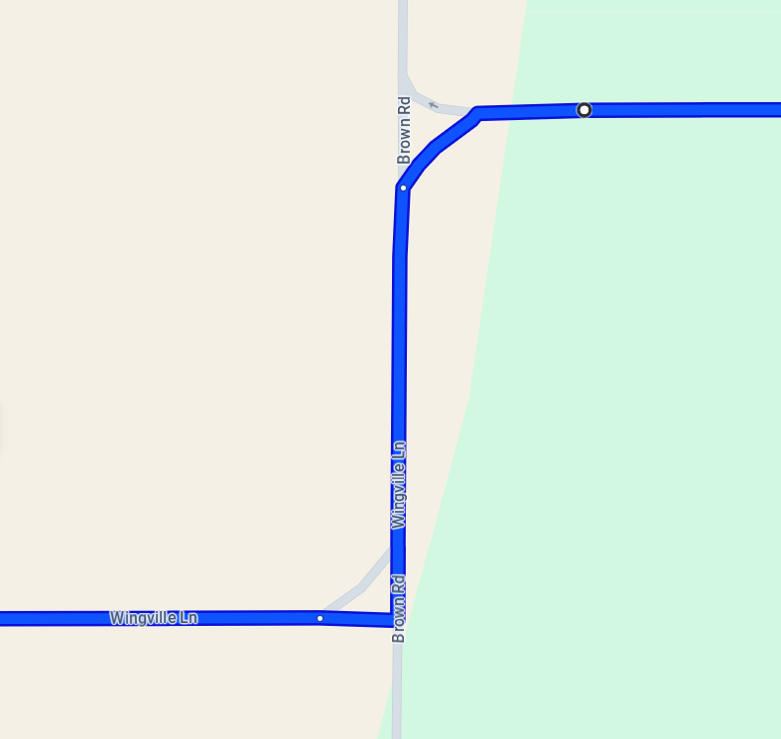
Notes:
Two corner marshals are required at this location

Slide 15
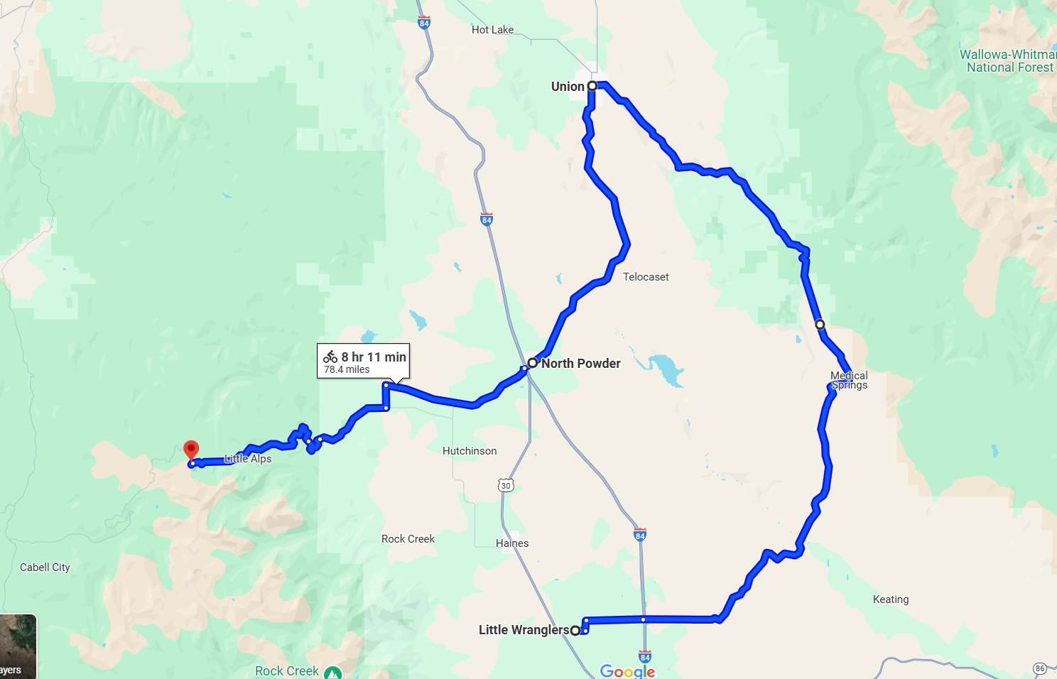
Stage 3

Slide 16
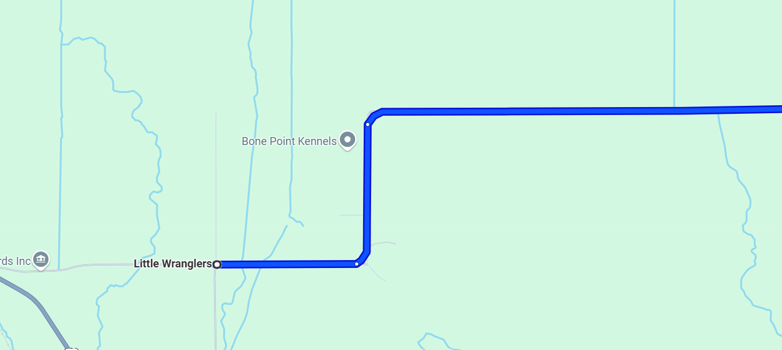
Notes:
One certified flagger is needed with 3 signs @500 ft to protect the racers starting with a pilot car and trail car for each group of riders

Slide 17
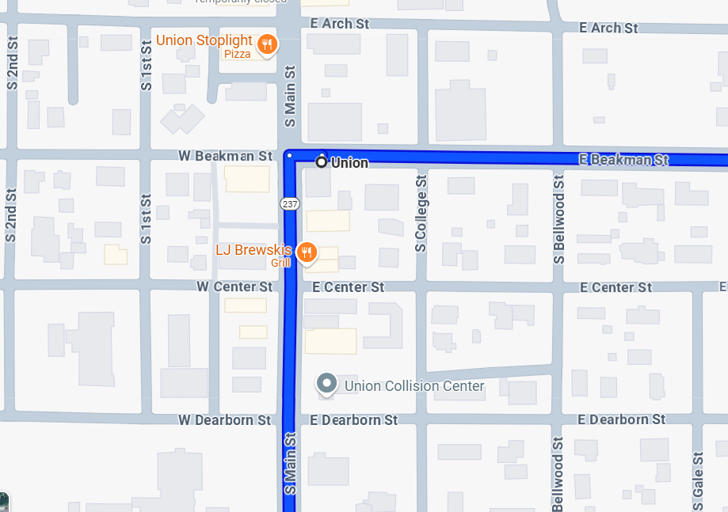
Notes:
Upon entering Union riders will make a right turn –two flaggers are needed at this location with signs posted @100 ft apart.

Slide 18
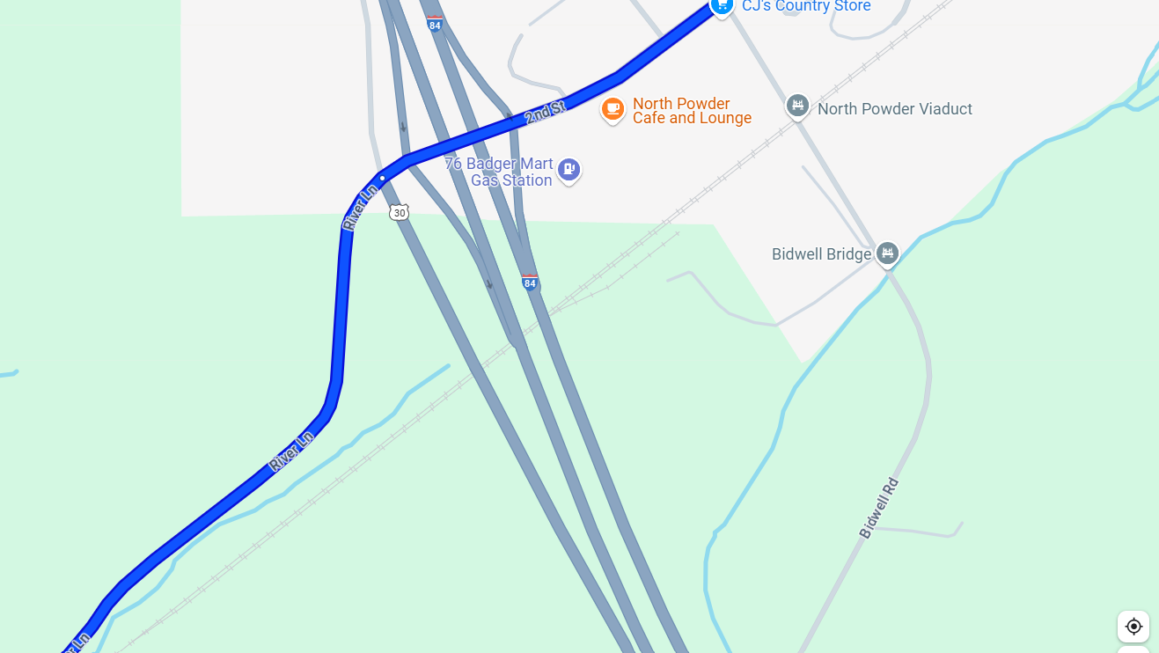
Notes:
North Powder requires 3 flaggers:
Protecting two off ramps coming off I84 onto North Powder with 3 flags @500 ft apart with a flagger on each ramp
Protecting frontage road and North powder with 3 flags @500 ft apart with 1 flagger protecting the traffic

Slide 19
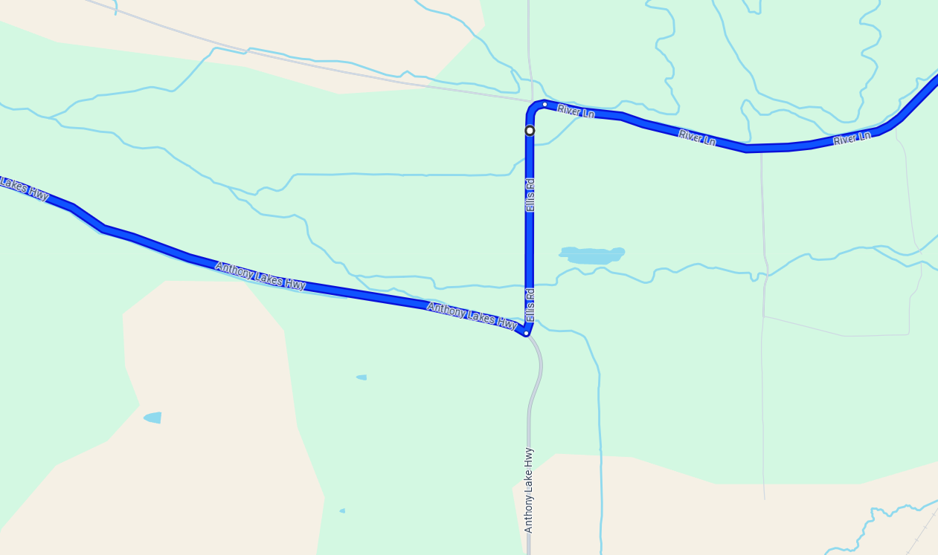
Notes:
Ellis road and North Powder road only requires two flagger with 3 caution flags 500 ft apart.

Slide 20
Key
Certified Flaggers
Corner Marshalls

